Slide 1
DIABETES VISUALISATIONS
Project 3 - Group 1: Brianna, Solomon, Marisa

Slide 2

Aims
Visualise diabetes among other top causes of death in the US.
Visualise diabetes prevalence over the years 2014-2019 across different states in the US.
Visualise how a potentially associated factor with diabetes, namely fast food restaurant, is distributed across the US.
Notes:
Marisa

Slide 3
Resources
Data sources: from the Centers for Disease Control and Prevention (CDC) and kaggle to create interactive maps and charts that allow for easy comparison and analysis of diabetes impact.
US Chronic Disease Indicators - https://chronicdata.cdc.gov/Chronic-Disease-Indicators/U-S-Chronic-Disease-Indicators-CDI-/g4ie-h725
Death causes csv downloaded - Monthly_Counts_of_Deaths_by_Select_Causes__2014-2019.csv
Obesity prevalence maps - https://www.cdc.gov/obesity/data/prevalence-maps.html
Fast food restaurants distribution - https://www.kaggle.com/datasets/khushishahh/fast-food-restaurants-across-us
Charts.js javascript library is used to generate the bar chart showing yearly death counts for top causes of death in the US.

Slide 4
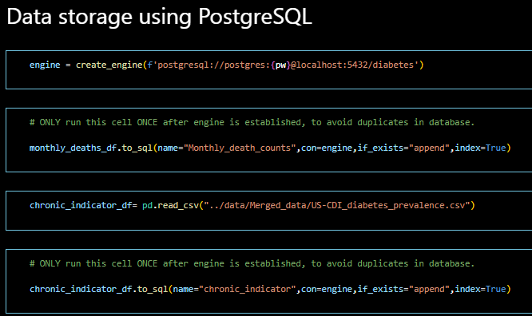
Data storage
Loaded into PostgreSQL.
Retrieved and cleaned using Jupyter Notebook
Notes:
Marisa

Slide 5
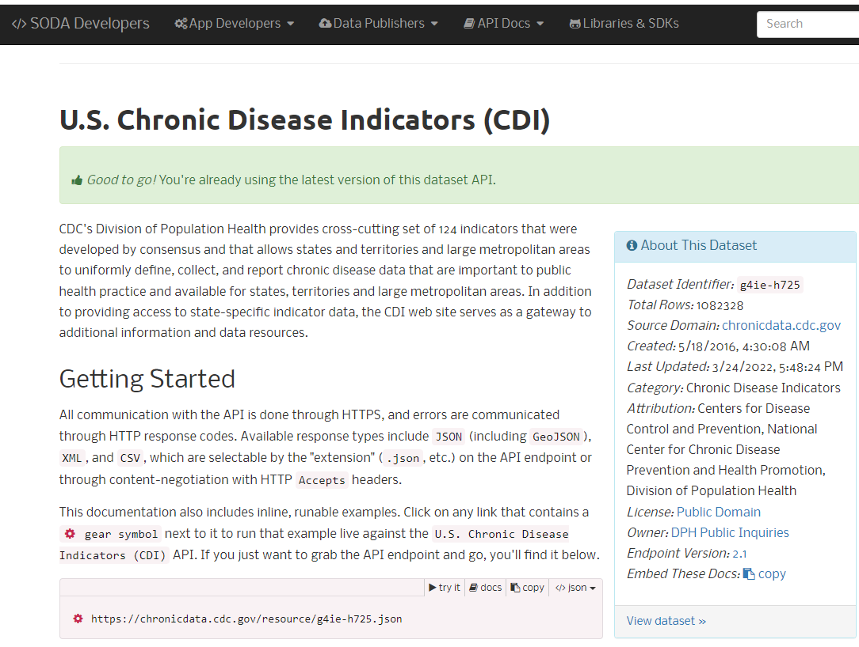
US Chronic Disease Indicators
Information for wide variety of topics,
not just Diabetes.
Problem: too much information!
Solution: API

Slide 6
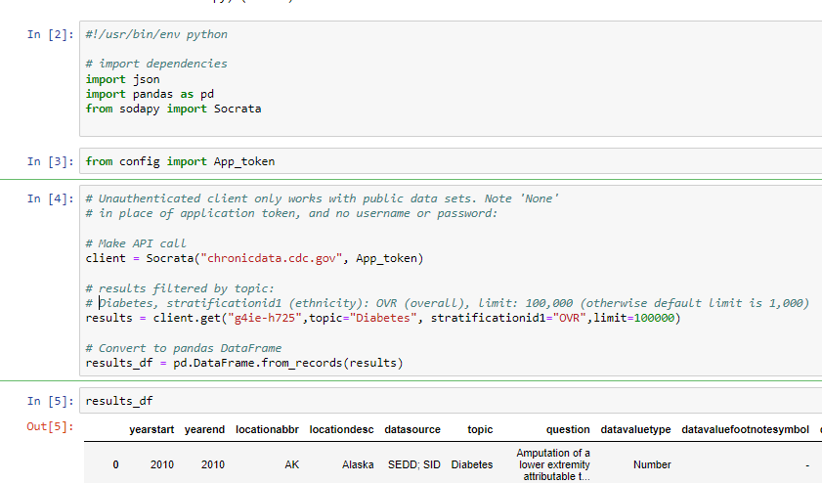
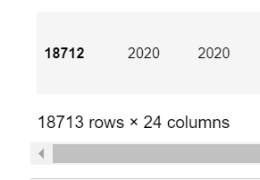
US Chronic Disease Indicators: Accessing the data
Massive dataset (over 1 million rows).
API available from CDC to access the dataset.
It took some trial and error to familiarize with the dataset and set ideal parameters for the API request.

Slide 7
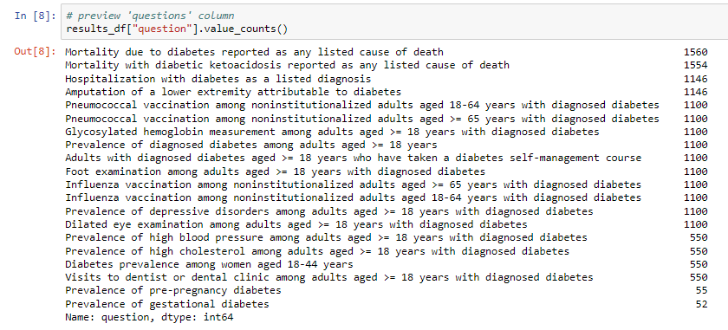
Deciding on a dataset . . . with the help of Pandas
What sort of information is available?
Is there enough data to create a suitable dataset?

Slide 8
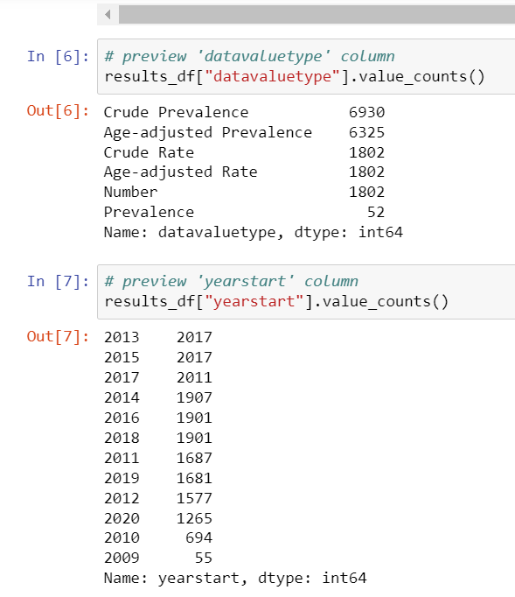
Cleaning & selecting
There was less data available for 2020 so we limited the dataset to 2014-2019.
We also limited the data to one data type rather than four. Age-adjusted Prevalence was selected.
Notes:
Brianna

Slide 9
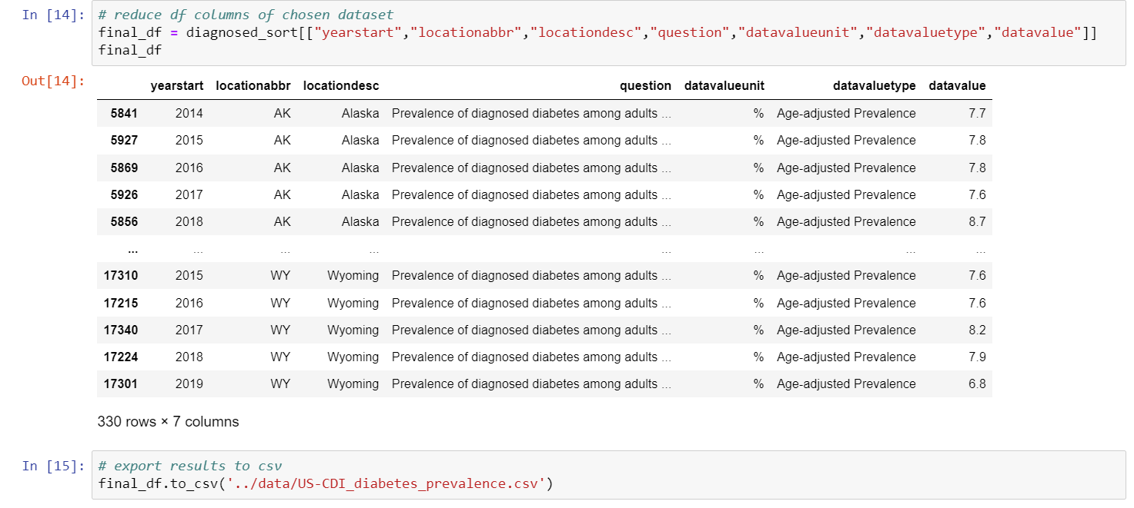
Output: 330 rows of data, divided by state/territory and year.
Saved to csv and json
D3 and Javascript used to read JSON file and structure data for plotting.
Data plotted using Charts.js. Event handlers update charts during user interaction.
Notes:
Brianna

Slide 10
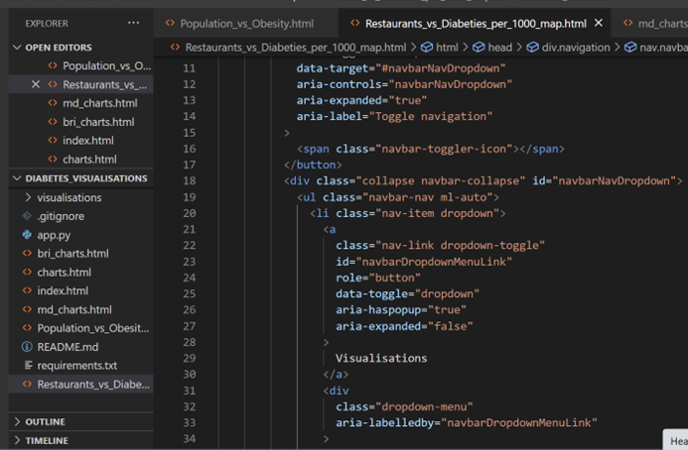
Front-end
A landing page, with link referring:
👍a dashboard page with multiple charts with dropdown that all reference the same data.
👍Leaflet and bootstrap to build maps.
Notes:
Solomon

Slide 11
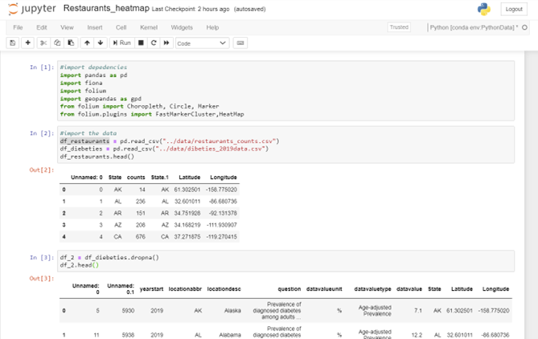
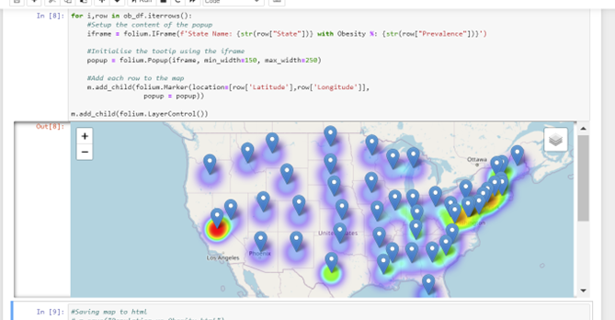
Maps & Folium
Created maps and visuals using Folium and Pandas in Python.
Automatically creates visuals and interactiveness.
Can do back end and front end work.
Exported to .html file.

Slide 12
Front-end
Deployed into https://marduo2022.github.io/Diabetes_visualisations
(can share screen during class and click this link to demonstrate front-end).
Notes:
Solomon

Slide 13

If we had more time… or for Future analysis
Create a timelapse Map showing Data points for different years.
Extract more datasets to compare with the Diabetes Dataset and create more analysis.
Create a more visually appealing landing page with backgrounds and visuals.
Create a plot showing the Diabetes Data with the number of restaurants in each state.
Notes:
Solomon

Slide 14
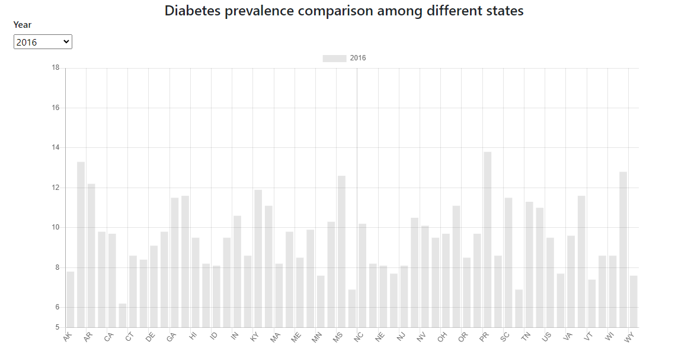
If we had more time…
Notes:
Marisa

Slide 15
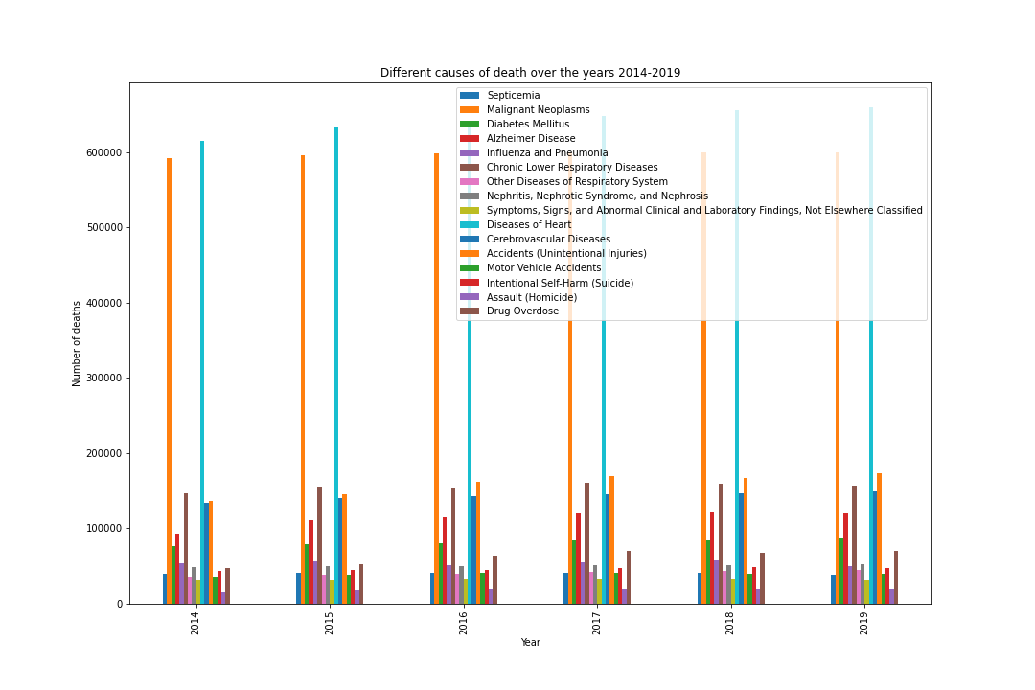
Conclusions
Diabetes is the among the top 10 causes of death.
Diabetes prevalence trends are varied across different states.
No obvious association with fast food distribution was observed.
Notes:
Marisa

Slide 16
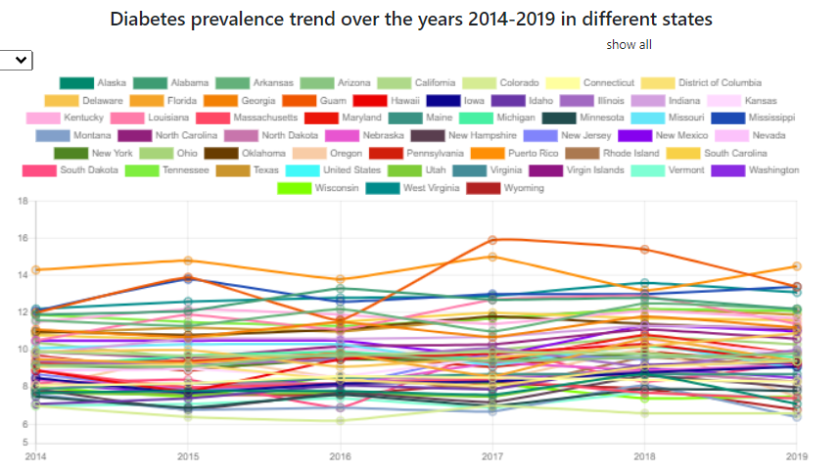
Conclusions
Diabetes is the among the top 10 causes of death.
Diabetes prevalence trends are varied across different states.
No obvious association with fast food distribution was observed.
Notes:
Marisa

Slide 17
Conclusions
Diabetes is the among the top 10 causes of death.
Diabetes prevalence trends are varied across different states.
No obvious association with fast food distribution was observed.
Notes:
Marisa

Slide 18
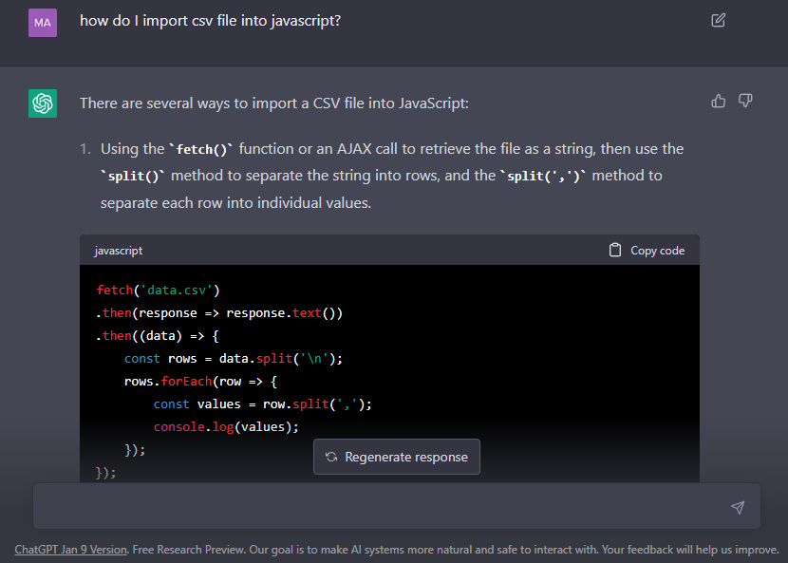
Interesting encounters
Importing csv into Javascript (to make charts) was surprisingly hard (compared to pandas).
ChatGPT was useful - helped with productivity.
Notes:
Marisa

Slide 19
